Slide 1
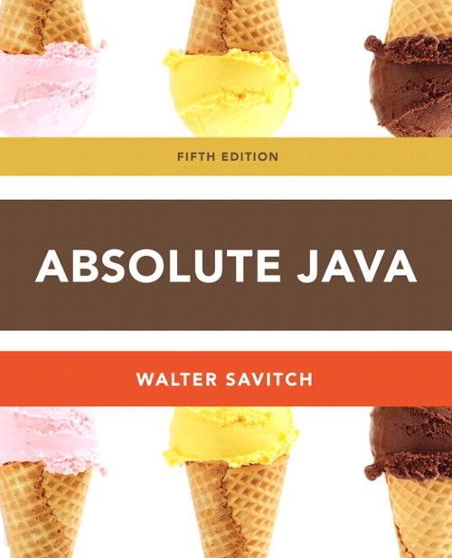
Chapter 3
Boolean Expressions
Section 3.2
Slides prepared by Rose Williams, Binghamton University
Kenrick Mock, University of Alaska Anchorage

Slide 2
Boolean Expressions
A Boolean expression is an expression that is either true or false
The simplest Boolean expressions compare the value of two expressions
time < limit
yourScore == myScore
Note that Java uses two equal signs (==) to perform equality testing: A single equal sign (=) is used only for assignment
A Boolean expression does not need to be enclosed in parentheses, unless it is used in an if-else statement

Slide 3
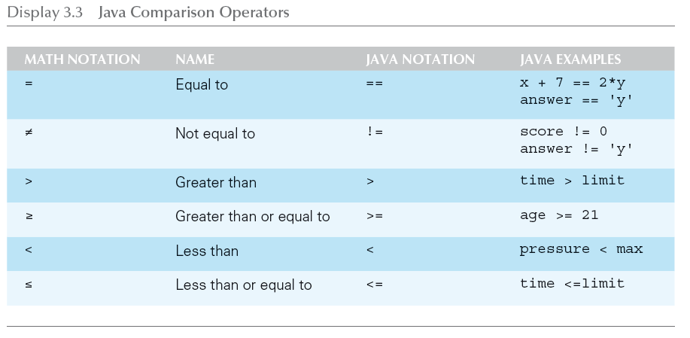
Java Comparison Operators

Slide 4
Pitfall: Using == with Strings
The equality comparison operator (==) can correctly test two values of a primitive type
However, when applied to two objects such as objects of the String class, == tests to see if they are stored in the same memory location, not whether or not they have the same value
In order to test two strings to see if they have equal values, use the method equals, or equalsIgnoreCase
string1.equals(string2)
string1.equalsIgnoreCase(string2)

Slide 5
Lexicographic and Alphabetical Order
Lexicographic ordering is the same as ASCII ordering, and includes letters, numbers, and other characters
All uppercase letters are in alphabetic order, and all lowercase letters are in alphabetic order, but all uppercase letters come before lowercase letters
If s1 and s2 are two variables of type String that have been given String values, then s1.compareTo(s2) returns a negative number if s1 comes before s2 in lexicographic ordering, returns zero if the two strings are equal, and returns a positive number if s2 comes before s1
When performing an alphabetic comparison of strings (rather than a lexicographic comparison) that consist of a mix of lowercase and uppercase letters, use the compareToIgnoreCase method instead

Slide 6
Building Boolean Expressions
When two Boolean expressions are combined using the "and" (&&) operator, the entire expression is true provided both expressions are true
Otherwise the expression is false
When two Boolean expressions are combined using the "or" (||) operator, the entire expression is true as long as one of the expressions is true
The expression is false only if both expressions are false
Any Boolean expression can be negated using the ! operator
Place the expression in parentheses and place the ! operator in front of it
Unlike mathematical notation, strings of inequalities must be joined by &&
Use (min < result) && (result < max) rather than min < result < max

Slide 7
Evaluating Boolean Expressions
Even though Boolean expressions are used to control branch and loop statements, Boolean expressions can exist independently as well
A Boolean variable can be given the value of a Boolean expression by using an assignment statement
A Boolean expression can be evaluated in the same way that an arithmetic expression is evaluated
The only difference is that arithmetic expressions produce a number as a result, while Boolean expressions produce either true or false as their result
boolean madeIt = (time < limit) && (limit < max);

Slide 8
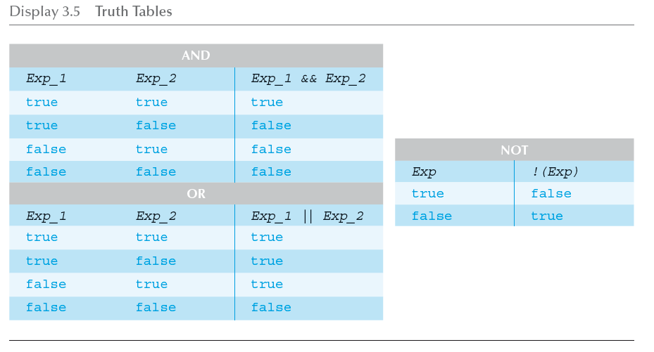
Truth Tables

Slide 9
Short-Circuit and Complete Evaluation
Java can take a shortcut when the evaluation of the first part of a Boolean expression produces a result that evaluation of the second part cannot change
This is called short-circuit evaluation or lazy evaluation
For example, when evaluating two Boolean subexpressions joined by &&, if the first subexpression evaluates to false, then the entire expression will evaluate to false, no matter the value of the second subexpression
In like manner, when evaluating two Boolean subexpressions joined by ||, if the first subexpression evaluates to true, then the entire expression will evaluate to true

Slide 10
Short-Circuit and Complete Evaluation
There are times when using short-circuit evaluation can prevent a runtime error
In the following example, if the number of kids is equal to zero, then the second subexpression will not be evaluated, thus preventing a divide by zero error
Note that reversing the order of the subexpressions will not prevent this
if ((kids !=0) && ((toys/kids) >=2)) . . .
Sometimes it is preferable to always evaluate both expressions, i.e., request complete evaluation
In this case, use the & and | operators instead of && and ||

Slide 11
Precedence and Associativity Rules
Boolean and arithmetic expressions need not be fully parenthesized
If some or all of the parentheses are omitted, Java will follow precedence and associativity rules (summarized in the following table) to determine the order of operations
If one operator occurs higher in the table than another, it has higher precedence, and is grouped with its operands before the operator of lower precedence
If two operators have the same precedence, then associativity rules determine which is grouped first

Slide 12
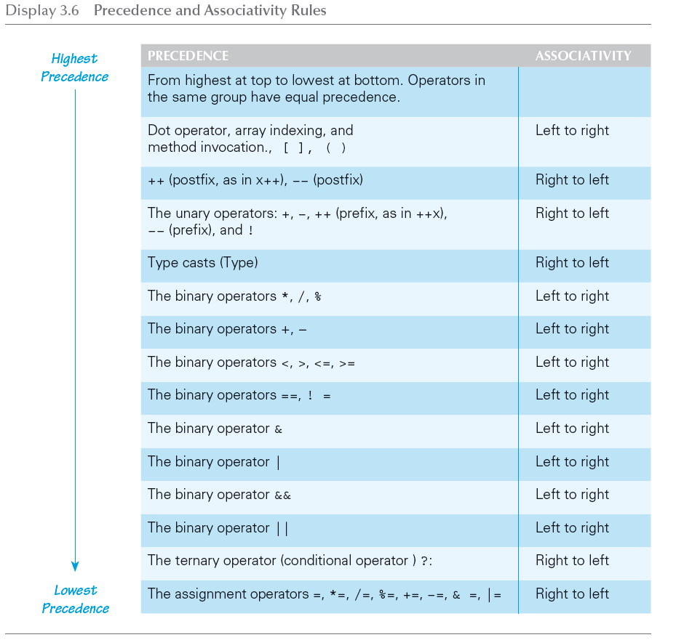
Precedence and Associativity Rules

Slide 13
Tip for Evaluating Expressions
In general, use parentheses in an expression to help to document the programmer's intent
Instead of relying on precedence and associativity rules, it is best to include most parentheses, except where the intended meaning is obvious

